Slide 1
APIM with Distinguishable Dyads: SEM Estimation
David A. Kenny
March 13, 2013

Slide 2
You Need to Know
APIM (click for webinar)
SEM
Knowing Amos helps

Slide 3
Example
Data Set: Acitelli dyad
Outcome:
Satisfaction (Wife and Husband)
Predictor Variable:
Other-Positivity (Wife and Husband)
How positive the Wife views her Husband, and how positive the Husband views his Wife

Slide 4
Model Specification
Use a dyad dataset.
Exogenous variables
The two X variables: OtherPos_W and OtherPos_H
Endogenous variables
The two Y variables: Satisfaction_W and Satisfaction_H
Make sure you estimate intercepts for the two Y variables.
This model is just-identified or saturated and has a chi square of zero with zero df.

Slide 5
Knowns and Unknowns
Knowns: 14
6 correlations
4 variances
4 means
Unknowns: 14
4 paths (2 actor and 2 partner)
4 variances (2 exogenous and two error)
2 covariances (exogenous and error)
2 intercepts (for Y)
2 means (for X)

Slide 6
Distinguishable Dyads Model

Slide 7
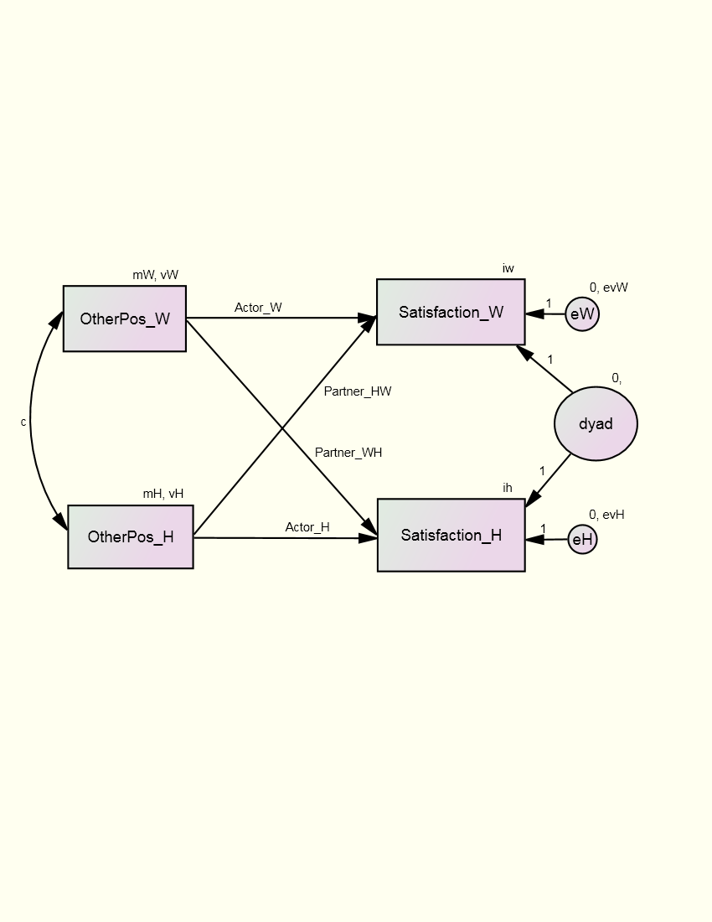
Random Intercept Model

Slide 8
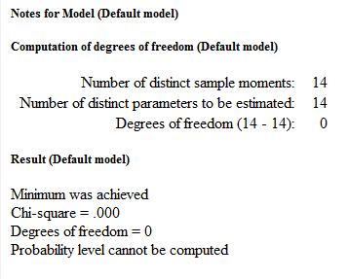
Results
Check Notes for Model page first in AMOS
Make sure you really estimated the number of parameters you wanted to estimate
Here you will also see any errors with model estimation

Slide 9
Results
Path Estimates (Regression Weights)
For one unit increase in how positively the wife views her husband, her own satisfaction goes up by .378 (wife actor effect) units and her husband’s satisfaction goes up by .262 units (wife partner effect)
For one unit increase in how positively the husband views the wife, his own satisfaction goes up by .424 (husband actor effect) units and his wife’s satisfaction goes up by .321 units (husband partner effect)

Slide 10
Results
Intercepts
Predicted values of satisfaction for husbands and wives when both other positivity variables equal zero
We could have mean centered other positivity variables to get more meaningful intercepts

Slide 11
Results
Covariances (and Correlations)
The correlations are more interpretable than covariance, but you look to the covariances for p values
A significant positive correlation between husbands and wives’ other positivity, r = .234, p = .006.
There is also a significant positive correlation between the husbands and wives’ error variances, r = .475, p < .001

Slide 12
Results
Means
Means for the other positivity variables
Variances
Typically it is good to see that all of these variances are different from zero because if not you may be in danger of estimation problems

Slide 13
Results
Squared Multiple Correlations
The squared multiple correlations are like R² estimates separately for men and women.

Slide 14
Model with Estimates

Slide 15
Standardizing
Do not use the standardized results in an SEM program, as it separately standardizes X₁ and X₂, as well as Y₁ and Y₂, separately.
Need to standardize across individuals and use the new variables in the SEM.
Use the average mean and variance of X₁ and X₂, as well as Y₁ and Y₂.

Slide 16
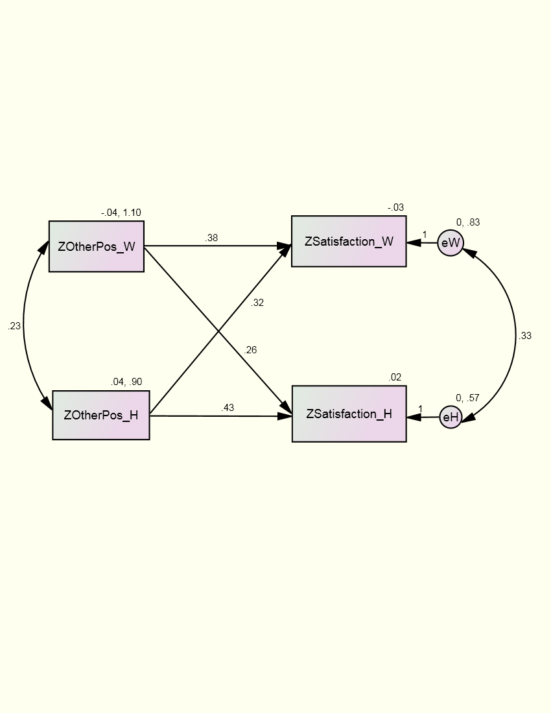
Standardized Estimates

Slide 17
Submodels
Examples
Equal actor or partner effects for the two members.
Actor or partner effects equal to zero.
Actor and partner effect effects equal (couple model).
Tests
Model no longer saturated and can use the chi square test or fit index to evaluate the constraint.

Slide 18
Results
Equal Effects
Actor: χ²(1) = 0.198, p = .656
Partner: χ²(1) = 0.314, p = .575
Both: χ²(2) = 0.328, p = .849
Zero Effects
Actor: χ²(2) = 32.745, p < .001
Partner: χ²(2) = 17.968, p < .001
Both: χ²(4) = 72.453, p < .001

Slide 19
Covariates
Examples
Relationship closeness
How long the dyad members have known each other
Strategy
Add them to the model as an exogenous variable.
Correlate with the two “X” variables.
Add paths to each “Y” variable.

Slide 20
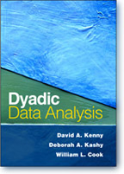
Additional Reading
Kenny, D. A., Kashy, D. A., & Cook, W. L. Dyadic data analysis. New York: Guilford Press, Chapter 5 and Chapter 7, pp. 168-169, 178-179.

